Slide 1

Icons for Circuit Sandbox.
See make_icon_uri.html for instructions on how to process these files.
Save as picture… png
To resize: open in Preview and set size to something x 18 pixels

Slide 3
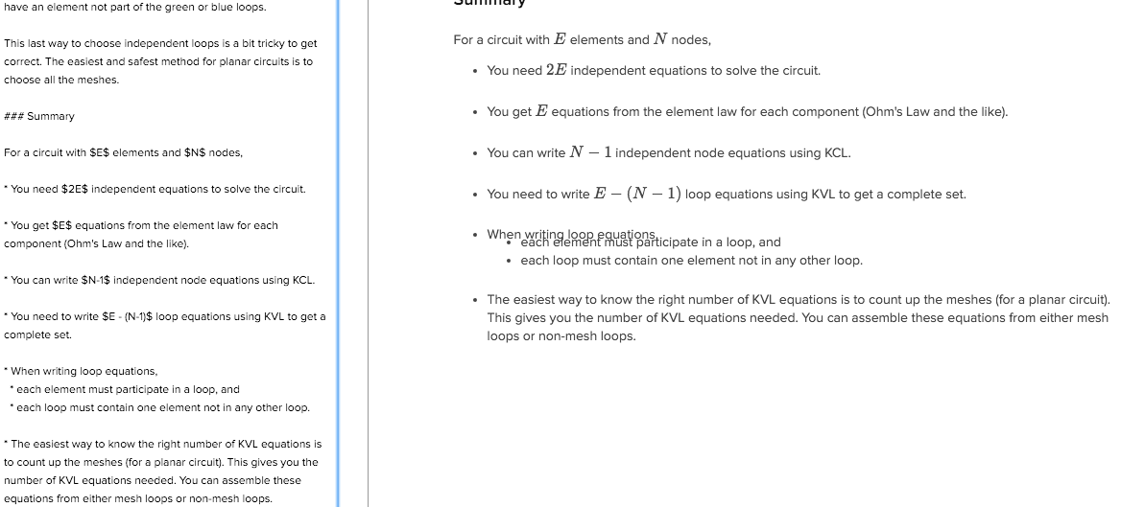
Why does this look bad?

